Slide 1

Diagnostic Potential for a Serum miRNA Neural Network for Detection of Ovarian Cancer
Final Presentation / Group1
111753501 Tao-hsiang Chang
111953216 Shi-rui Liang
111753213 Yun-hung Chiang

Slide 2

Abstract
Non-coding RNA’s in epithelial ovarian cancer(EOC)
Small RNA seq from 179 human serum samples
Produced a miRNA algorithm w/ neural network analysis
AUC 0.9; 95% CI: .81 - .99, outperform CA125
Results such as 100% specificity for ovarian cancer
Suggests circulating miRNAs have potential to develop a non-invasive diagnostic test for ovarian cancer
1/18
Notes:
We want to look at what is this paper talking about first.
It says there is research on non-coding RNA‘s role that has shed a light on EOC, and this is the motivation and the starting point of this paper.
Then beginning with sample analyzing and modeling from 179 human serum samples, they produced a miRNA algorithm with neural network analysis which has an incredible performance: AUC 0.9 and 95% CI between .81 and .99. They compared the result with the current method which is called CA125, and the neural network model outperformed it in every aspect. Then they did a lot more and get amazing results, such as 100% specificity for ovarian cancer, etc.
At the end of this paper, it suggests circulating miRNAs have the potential to develop a non-invasive diagnostic test for ovarian cancer.

Slide 3
Introduction
EOC is the leading cause of death
From gynecologic cancer among women in developed countries
Current used CA125 is limited in capabilities
miRNAs (microRNAs) showed great potential
Short non-coding RNAs that regulate gene expression
Advantages over protein measures:
PCA amplifies the detection of rare transcripts in blood
Same units of measure, easing incorporation into multiplexed panels
Critical role in ovarian cancer biology, where CA125 is unknown
Objective: serum-based miRNA model for ovarian cancer
2/18
Notes:
In the introduction, this paper described that EOC is the leading cause of death, from gynecologic cancer among women in developed countries, and, the currently used method, which is called CA125, is limited in its capabilities in many ways, so this is a research area.
From some other research, the microRNAs showed great potential in detecting cancer such as EOC. The miRNAs are short non-coding RNAs that regulate gene expression, and they have some advantages over protein measures, such as PCA amplifies the detection of rare transcripts in blood; miRNAs use the same units of measure, easing incorporation into multiplexed panels; miRNAs play a critical role in ovarian cancer biology, where the function of CA125 is unknown.
So, the object of this paper becomes clear now: to develop a serum-based miRNA model for ovarian cancer.

Slide 4
Sequencing Data
Full RNA samples from 180-1 patients (dataset 1)
Download from NCBI>GEO>GSE94533
Use SRA Run Selector to select and deliver from AWS Cloud
48.88Gb in Bytes, 130.20G in Bases
Average 10m read per sample
Metadata, family data(contact), cohort summary
miRNA samples from 454 patients (dataset 2)
Download from NCBI>GEO>GSE31568
886Kb txt file for series matrix
Raw data, miRNA sequence table (41Kb)
3/18

Slide 5
Supplementary Files
STATISTICA source code (for ML models) *4
Supplementary files *6
Files that describes properties and/or provide params
Details not in the paper (such as CA125 comparison)
Supplementary datasets
4/18

Slide 6
Methods & Results
Pre-treatment subjects: (samples from) 179 women
From ERASMOS, PMP and NECC’s studies (dataset 1)
Statistical tools & machine-learning on miRNA-seq
Algorithm discriminating ovarian cancer from others
Began by using 3 different strategies for select miRNA
Significance-based (by t-test)
Correlation-based feature subset
Expression fold change
11 models compared by AUC/sensitivity/specificity
5/18
Notes:
The methods & results of this paper can be broken into 2 parts, so we‘ll start with the first part.
This part of the samples is from 179 pre-treatment women, which is from studies in ERASMOS, PMP, and NECC that have some different characteristics. This is the dataset output from this research, and called dataset 1 here.
They used some statistical tools and machine learning techniques on miRNA sequences, and as described in the abstract, the algorithm has great performance. It discriminates ovarian cancer from other cancers. This modeling began by using 3 different strategies for selecting miRNAs to be used. There are a total of 18 miRNAs repeatedly classified into these three strategies listed here.
11 models are used to compare 3 performance metrics: AUC, sensitivity, and specificity.

Slide 7

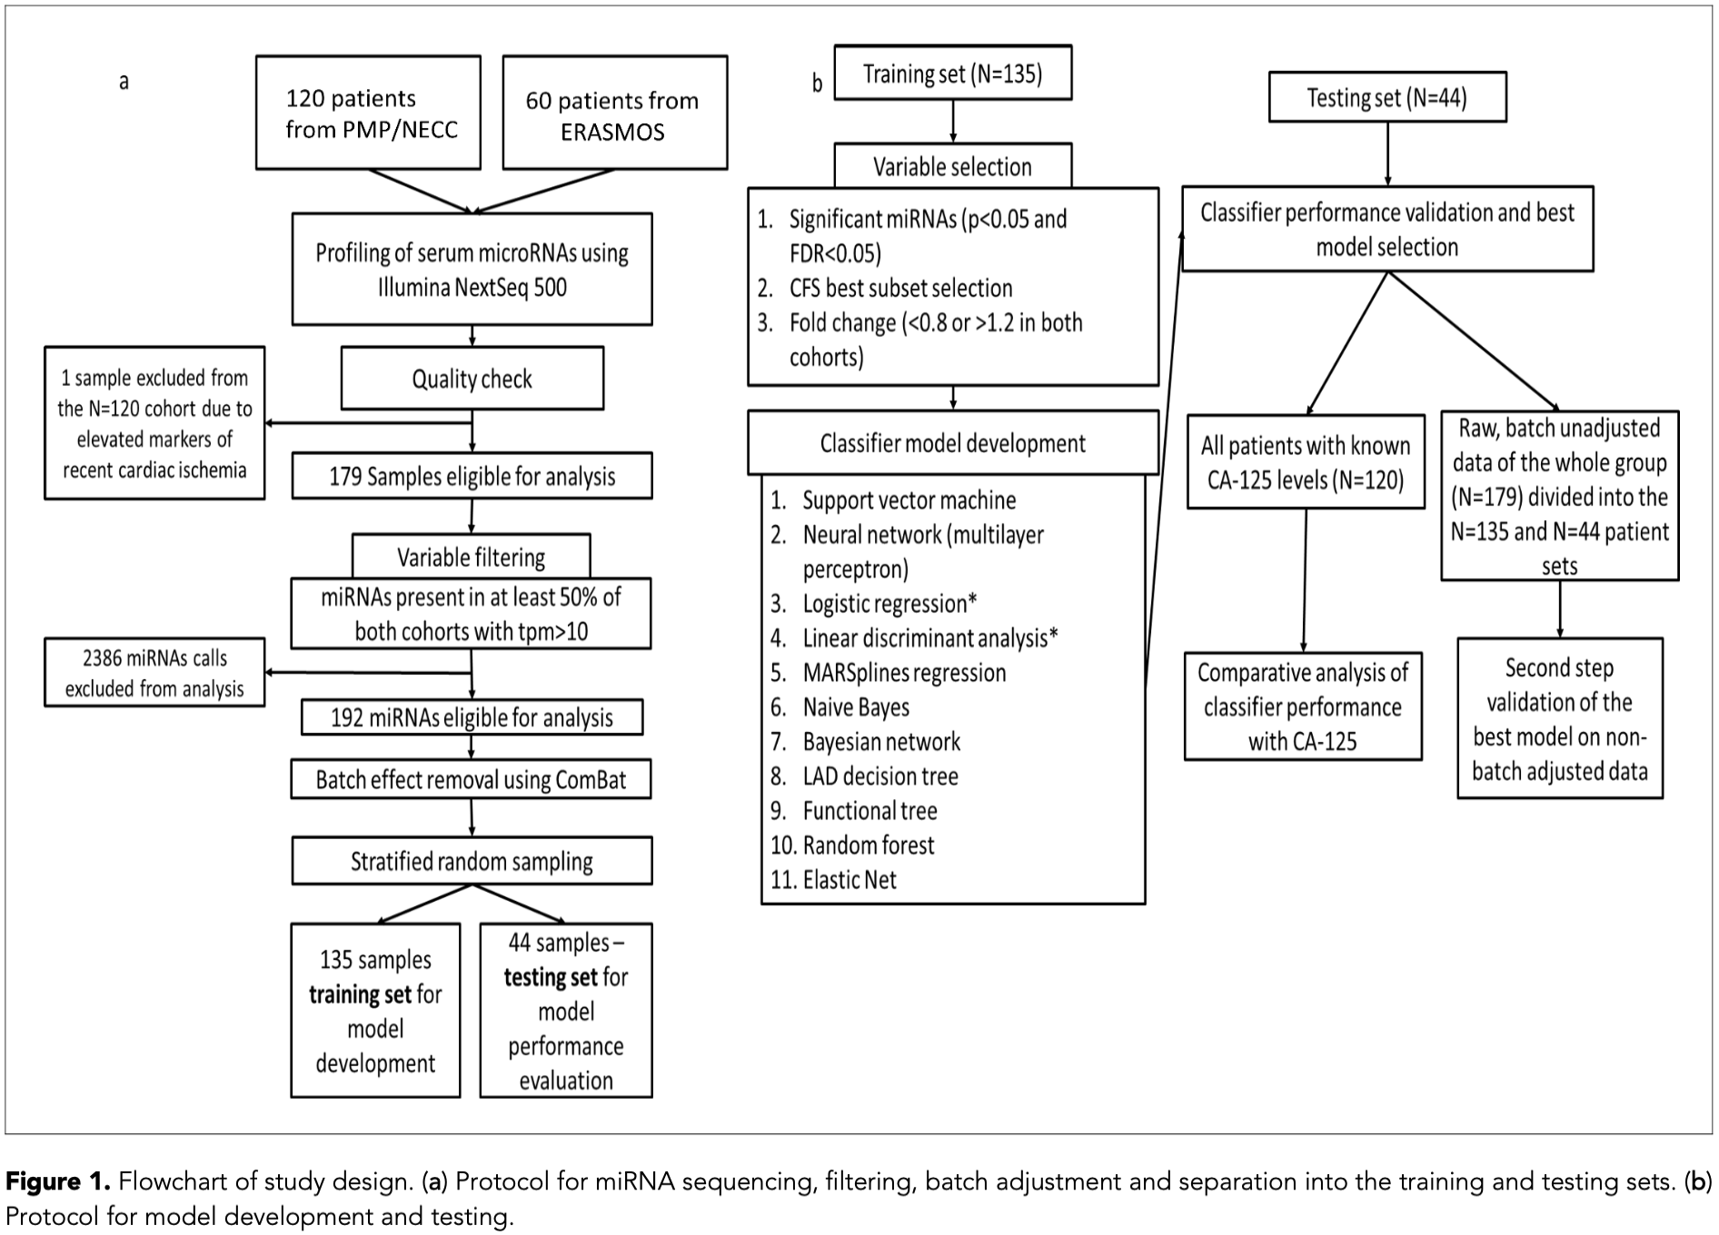
6/18
Notes:
This is apparently a flow chart. It described: a) protocol for miRNA sequencing, filtering, batch adjustment, and separation into the training and testing sets. Which is the left part of this diagram. It collected a total of 180 patient samples from 3 different studies, profiling and checking them, and excluded 1 sample, making it 179 samples for analysis. Through variable filtering, they only chose miRNAs present in at least 50% of both cohorts with tpm>10, and it left 192 miRNAs eligible for analysis. After the batch effect was removed, the samples is randomly parted into the training set and testing set in a 3:1 ratio, ending this part.
b) protocol for modeling development and testing. Which is the right part of this diagram. From the training set, it goes through variable selection again, and used the training set to model 11 different classifiers which are used to classify the testing set in 3 strategies mentioned earlier, and finds the neural network model gets amazing results. It then compared with the current CA125 method, and also tried to combine CA125 either as a second layer or a second review, but it turned out to be worked worse.

Slide 8
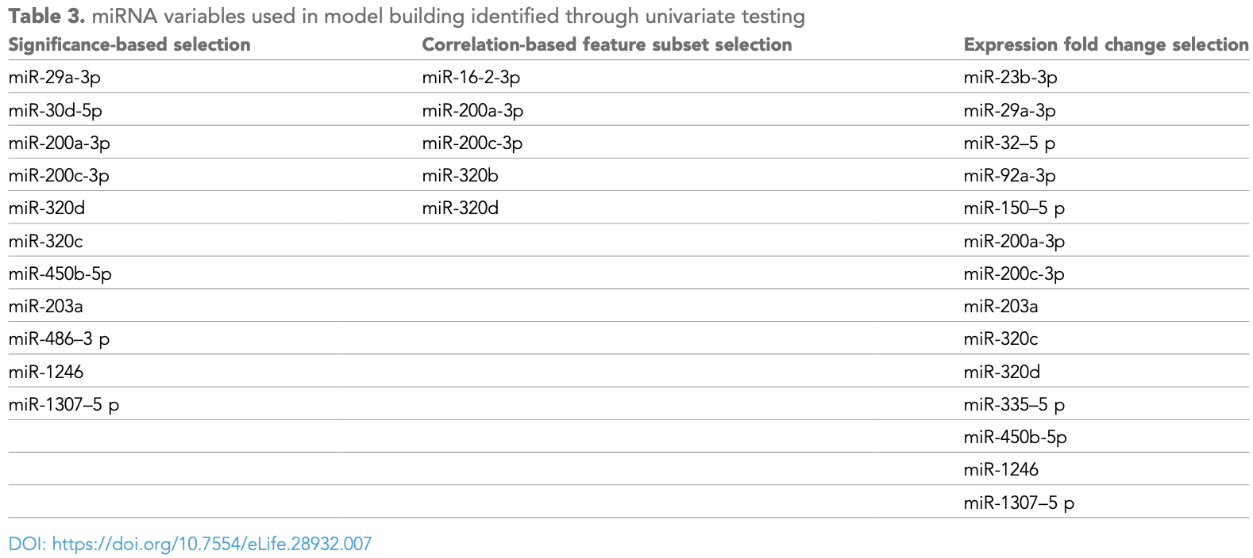
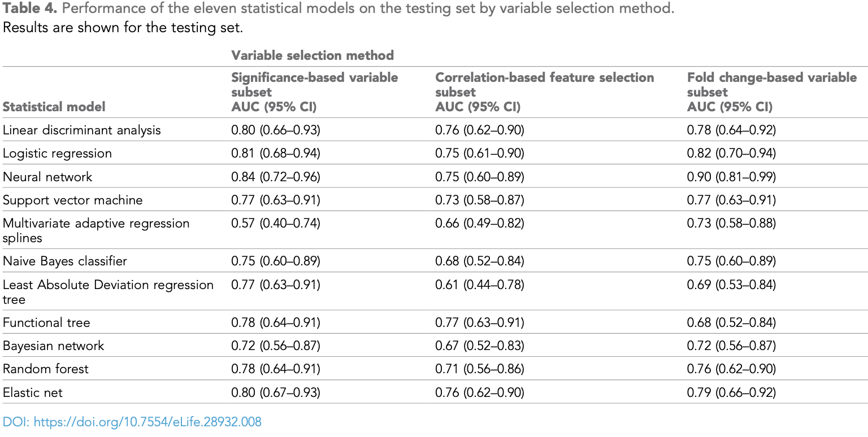
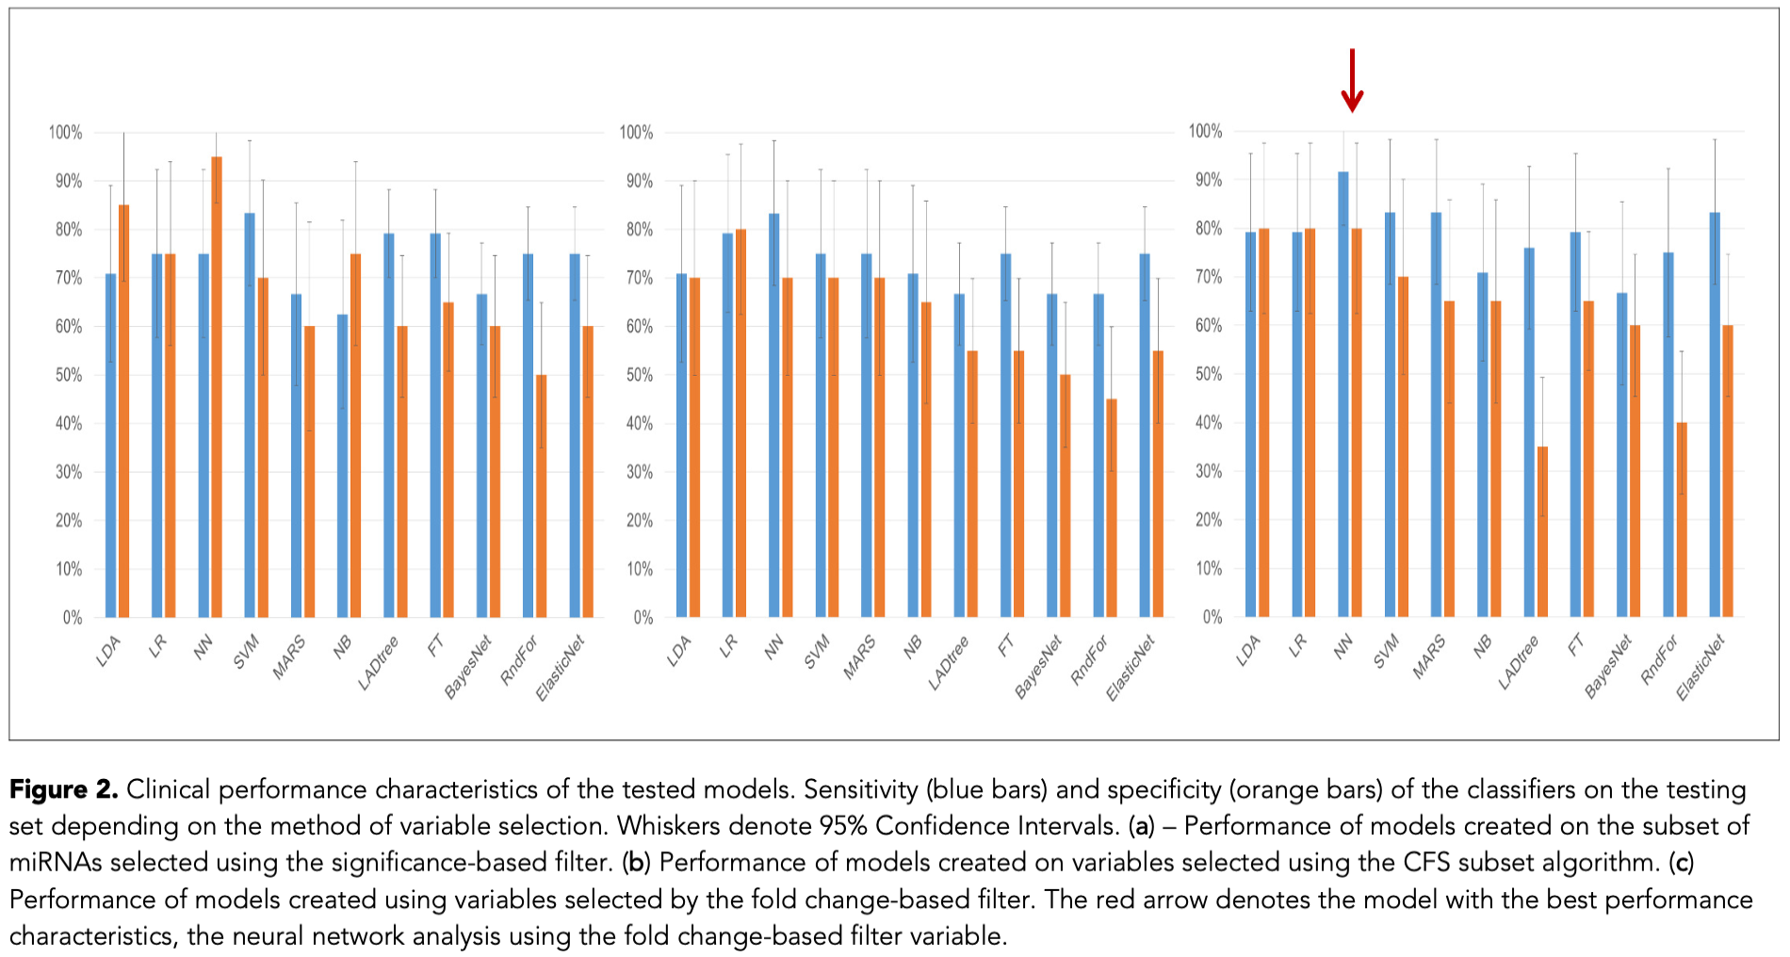
7/18
Notes:
Table 3 in the top-left corner listed a total of 18 different miRNA variables used in model building, as described in the last slide, and it is categorized into 3 strategies
Table 4 is the 11 models, which are also mentioned in the last slides, they are used in different strategies and get different AUC as well as sensitivity and specificity. From the result, they find out that the neural network model meets their standard, and outperformed the current CA125 method in every aspect.

Slide 9
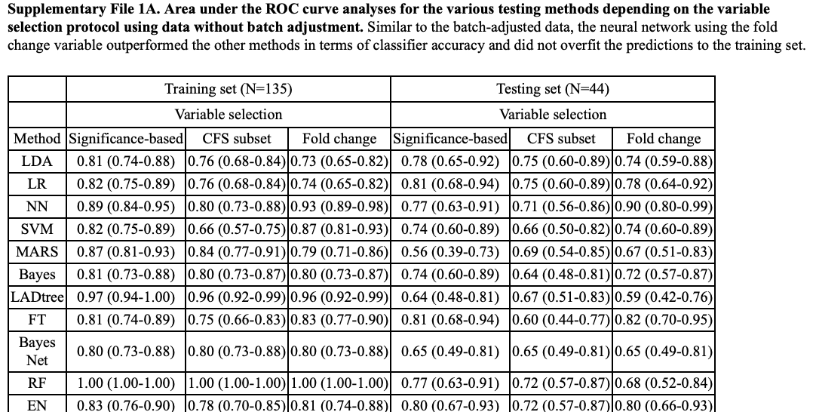
Figure 2:
Step 1: Get Dataset 1
Step 2: Use the given code in the supplemental file and paper to train 11 models
Get AUC/specificity/sensitivity and compare
Problem
We don’t know how training/test data is selected
Plot data is given
8/18

Slide 10
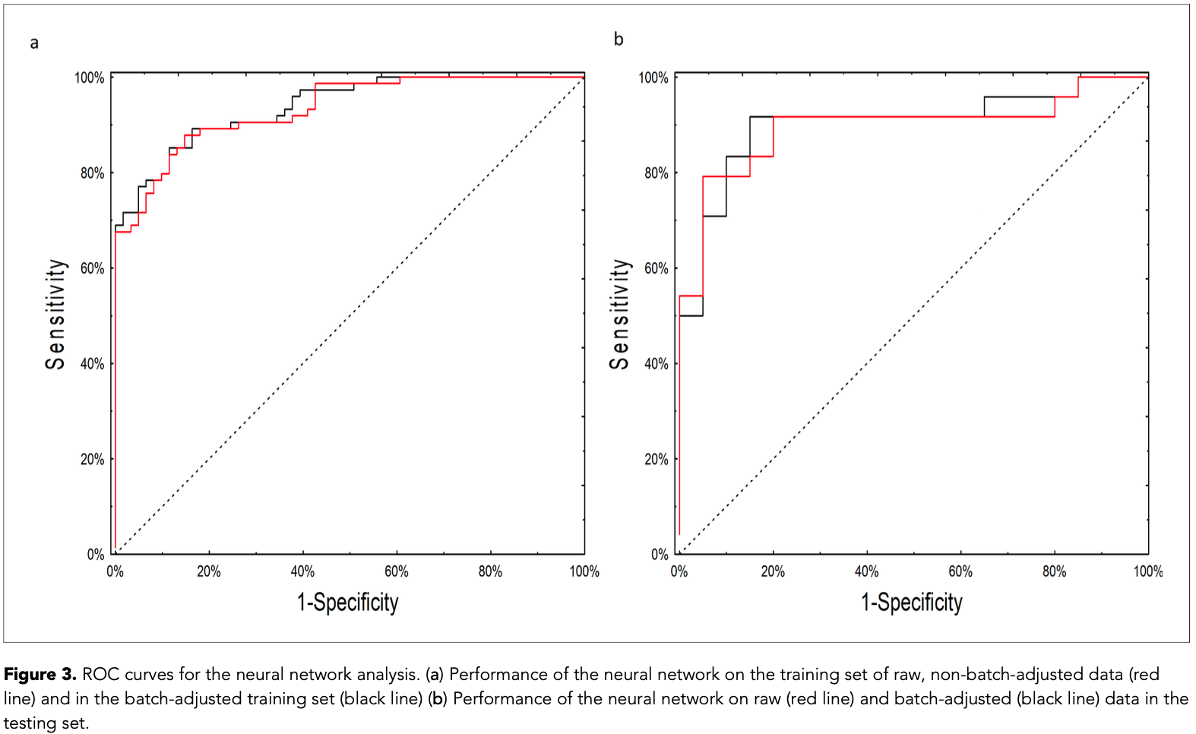
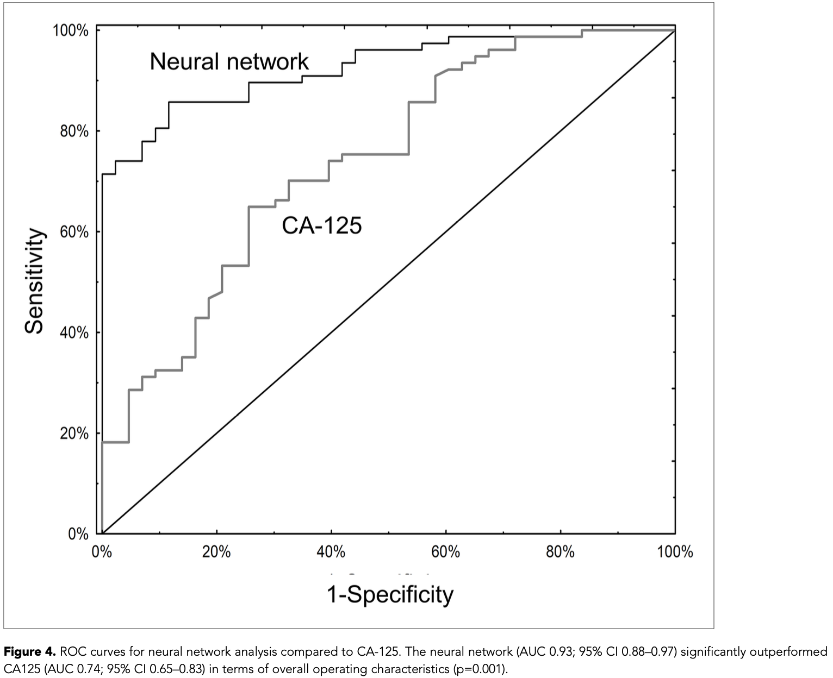
To train models:
Step 1: Get Dataset 1
Step 2: Use the given code in the supplemental file and paper
We were not able to plot Figure 3-4:
Connection from AWS us-east-1 to the campus is way too slow.
Not able to download required data to build model
9/18

Slide 11
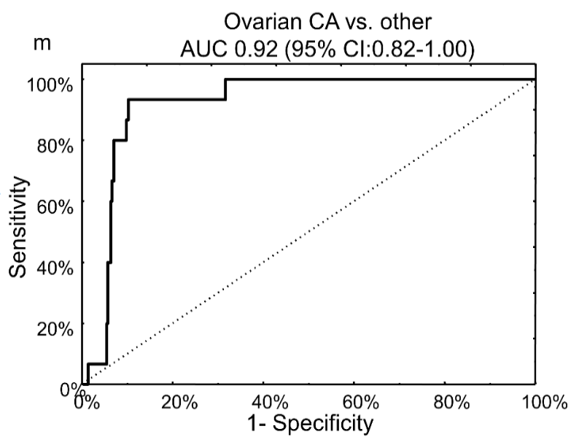
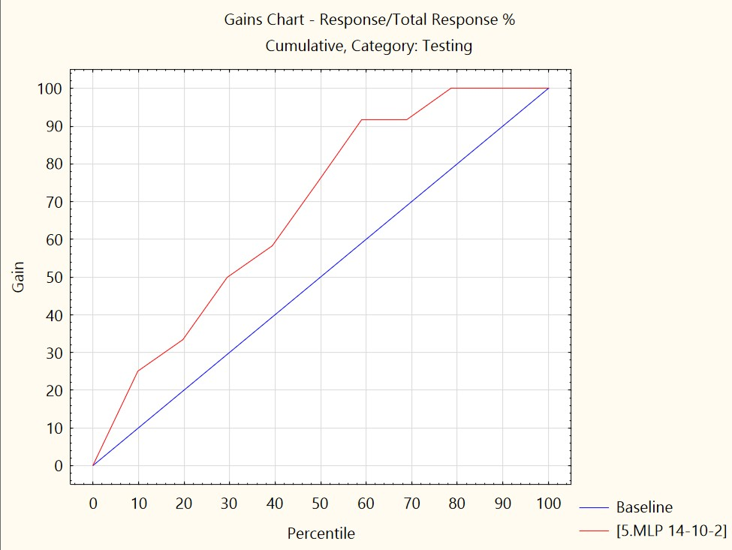
Figure 5
We still don’t have model…
But the Supplemental Dataset 7 from Supplement File 6 gave us information to plot
10/18

Slide 12
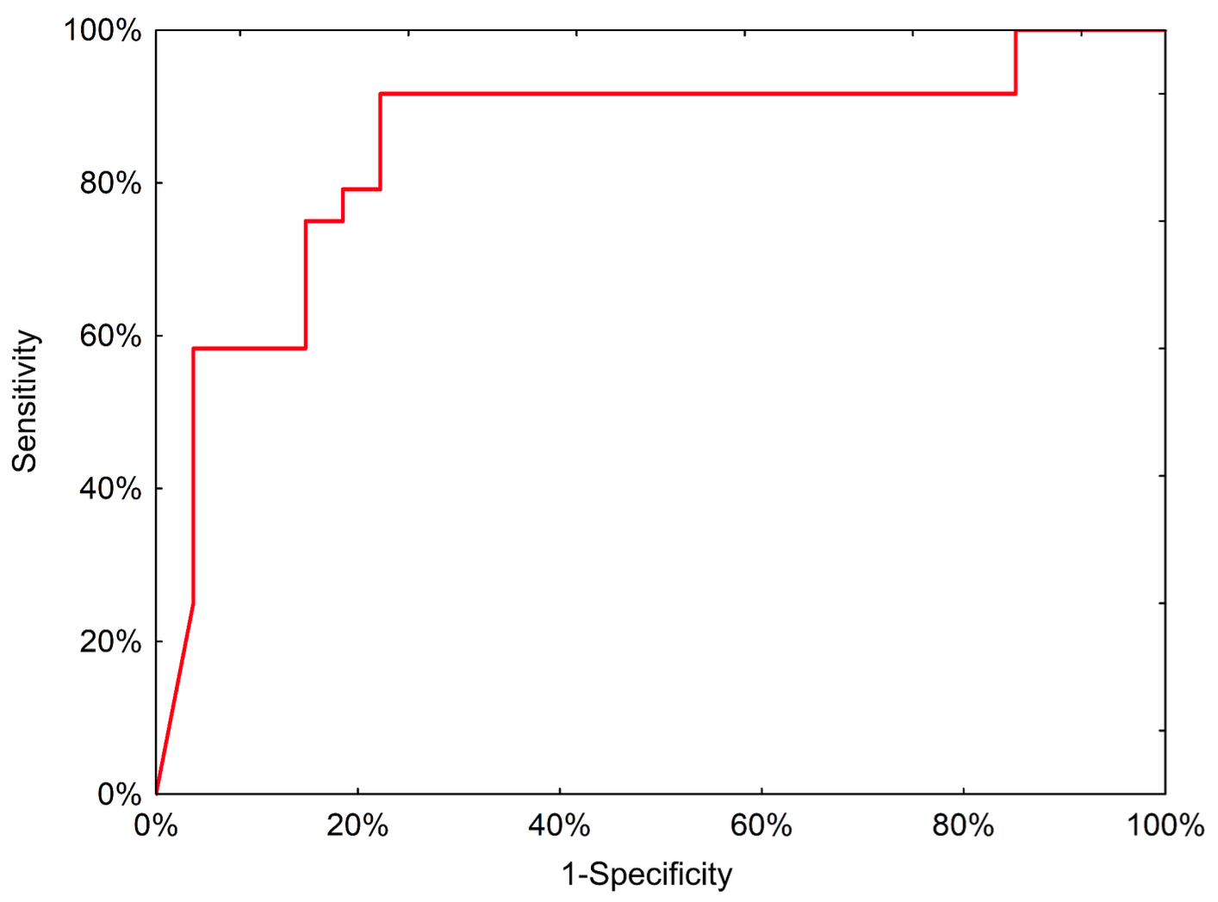
Methods & Results (2)
Next generation sequencing
Measuring miRNAs from the neural network using qPCR
Previous 120 samples by qPCR:
Internally validated 14 miRNAs in the neural network (+9)
Reduce to only 7 miRNAs + 4 normalizers
Plus 205 more => 325 samples for qPCR model (dataset 2)
Test on external samples from 51 patients in Poland
11/18
Notes:
That is the end of part one, which proves the potential of miRNAs with neural network modeling.
The second part of this paper is focusing on neural network modeling. It now measures miRNAs from the neural network using qPCR. They used the 120 samples from the previous part by qPCR and reduced the miRNAs from the original 18 to only 7 miRNAs and 4 normalizers.
They also plus 205 more samples from another study of a total of 454 samples which is called dataset 2. This made it a total of 325 samples for the qPCR model.
They tested this model on external samples from 51 patients in Poland and gets a good-looking ROC curve, as expected. Furthermore, this model tested with dataset 2, which has 14 different cancers, and turned out this model is only good with detecting EOC, which means to detect different cancer, it will need to build different models, and that is reasonable.

Slide 13
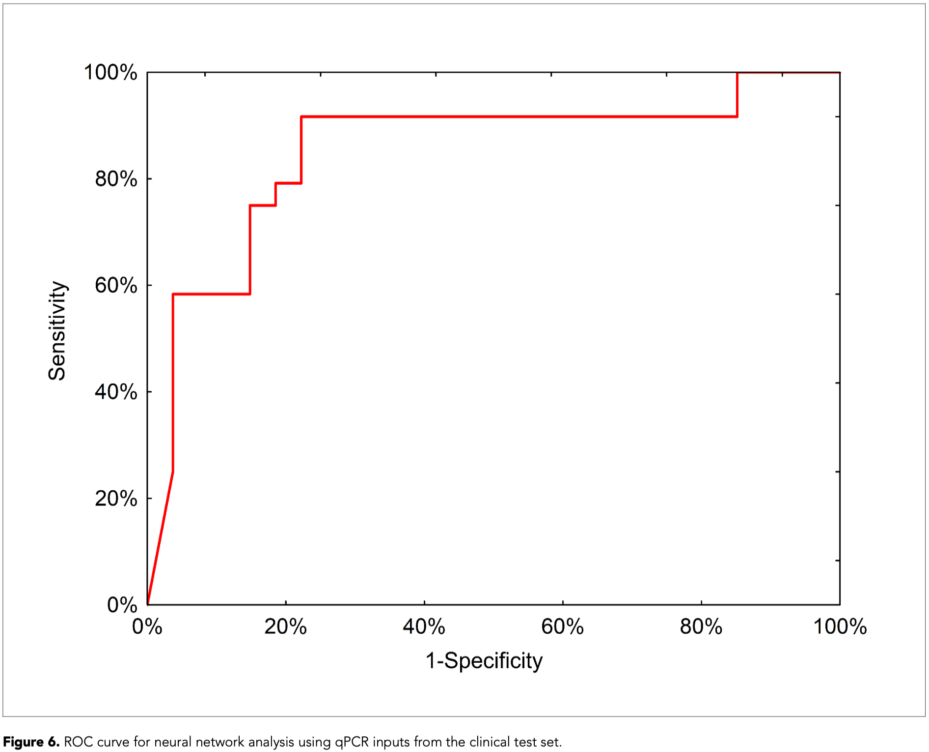
Figure 6
We were not able to reproduce this figure
One reason is the paper didn’t give information for the “external model”
Another is we don’t have our model trained yet
12/18

Slide 14
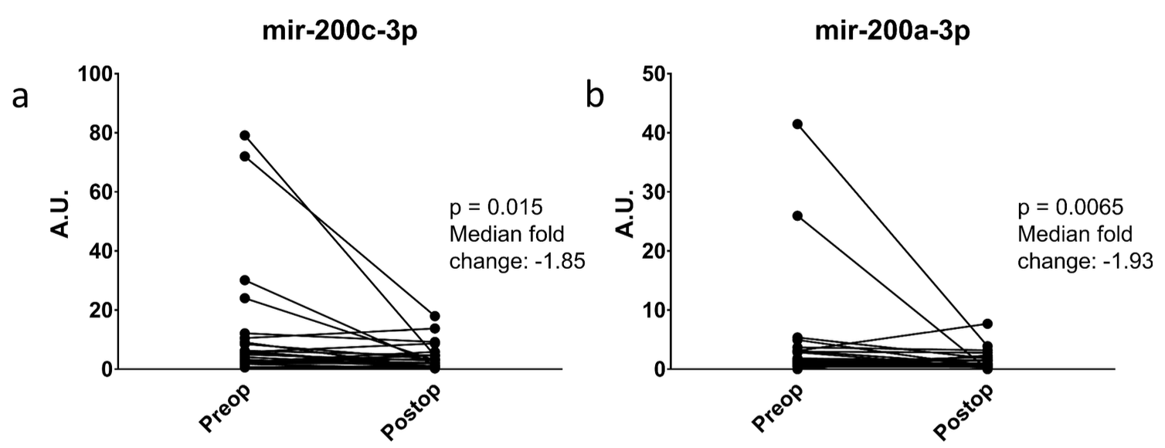
What’s More
Measuring miRNAs pre/post ops
decreased, and significant changes in some miRNAs
Examine if the miRNAs were coming from disease
Suggesting present even in early lesions
Constructed a web calculator to demonstrate how to use these models
http://biostat.umed.pl/ovaries
13/18
Notes:
At the end of part 2, they have done a few more things including:
They measured miRNA pre/post operation since the miRNAs might be reduced after the tumor is removed. And yes, the miRNAs decreased and has significant changes in some miRNAs as shown in the figure.
They also examine if the miRNAs were coming from the cancer tumor, so they measured the patients’ serum samples that saved from an earlier stage and found they do have a relationship. This suggests the miRNAs do come from cancer, so the miRNAs are present even in early lesions, making it a great tool to detect EOC even in the early stage.

Slide 15
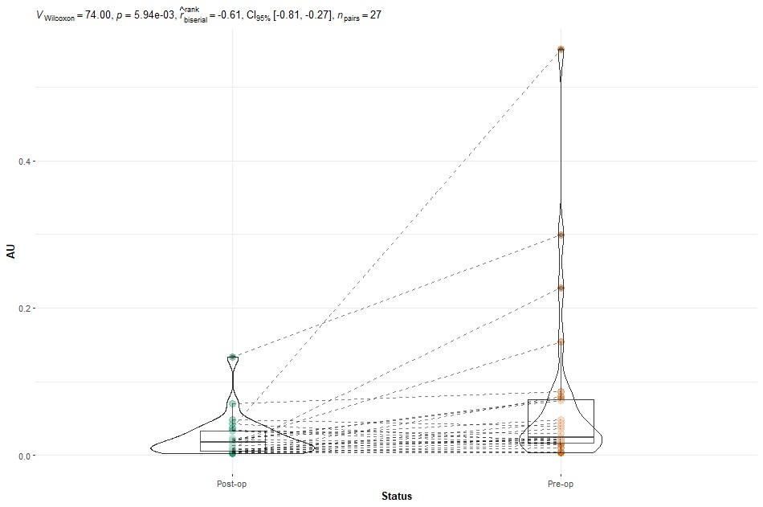
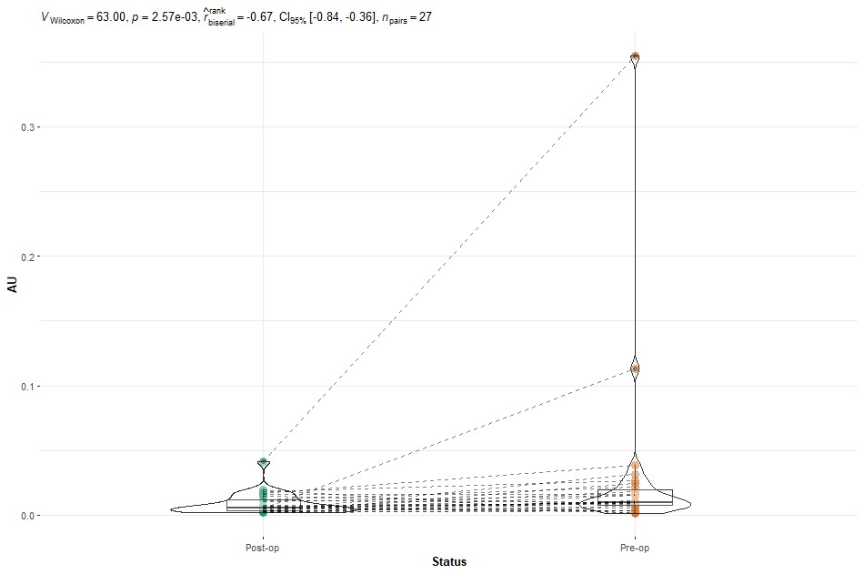
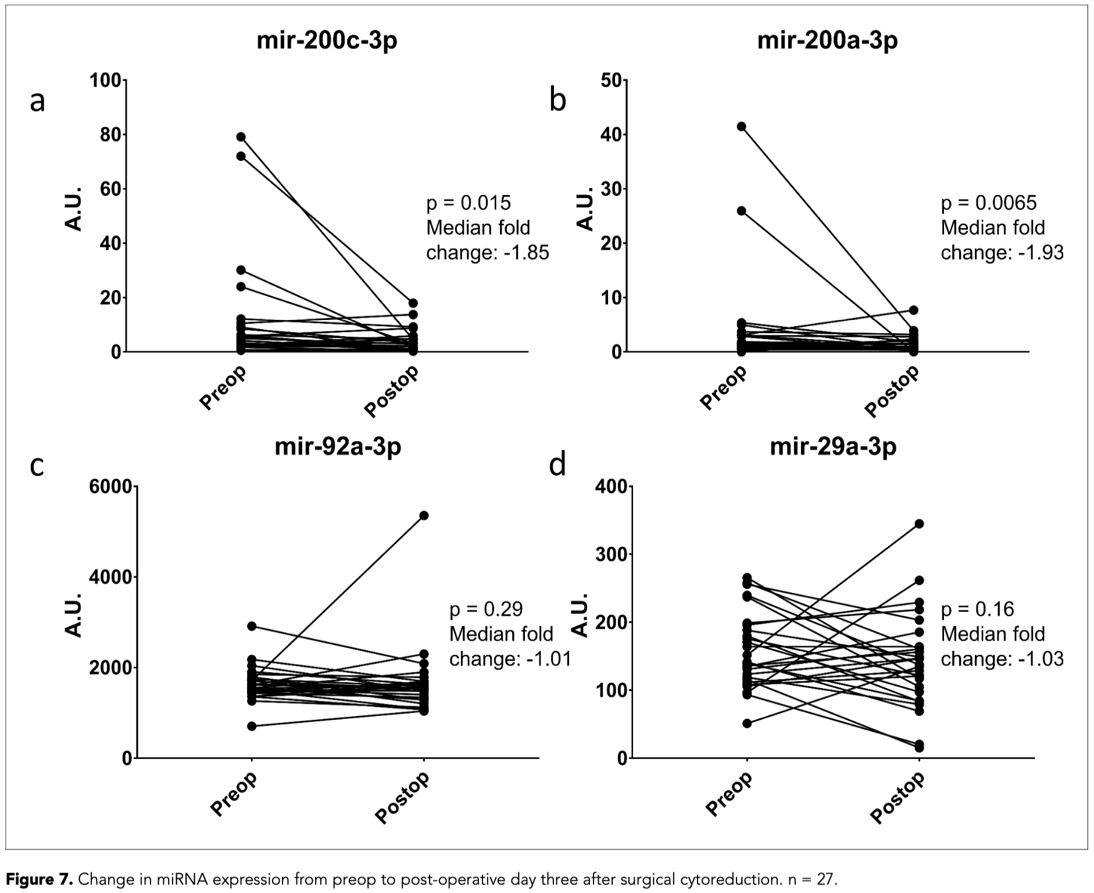
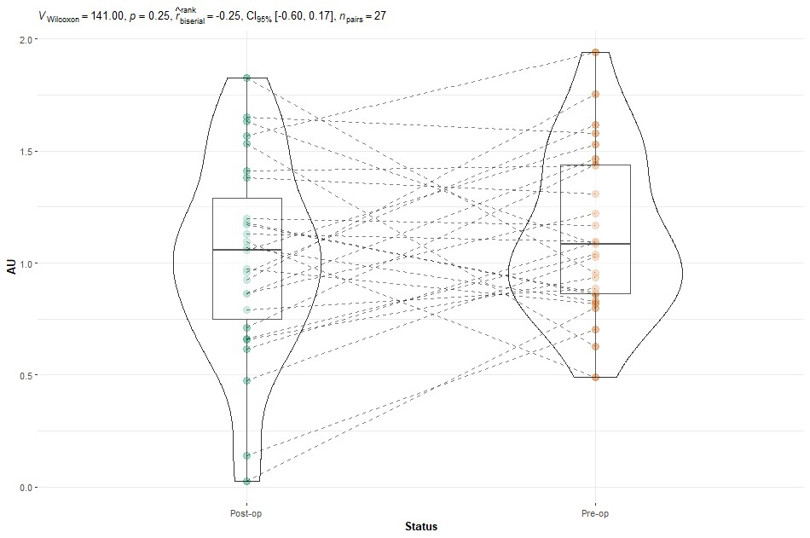
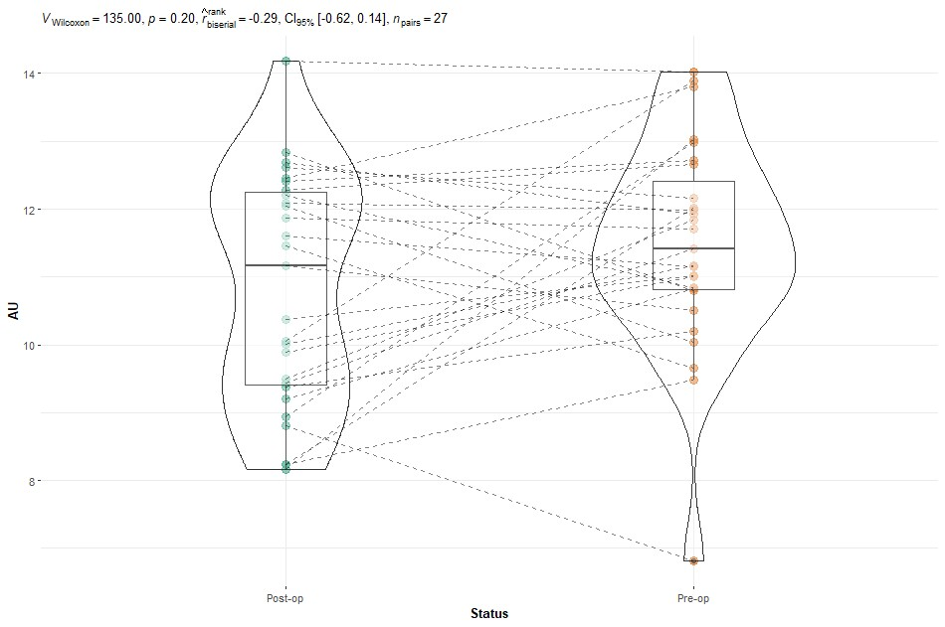
Figure 7
Data from Supplemental Dataset 8 (File 6)
Didn’t know tool used… We used Pairwise Wilcoxon Test Graph R code
14/18
Notes:
Figure 3 is the ROC curves comparison with the training set and test set, and they have pretty similar results.
Figure 4 in the bottom is the ROC curves comparison between the neural network and CA-125, and we can clearly see the difference.

Slide 16
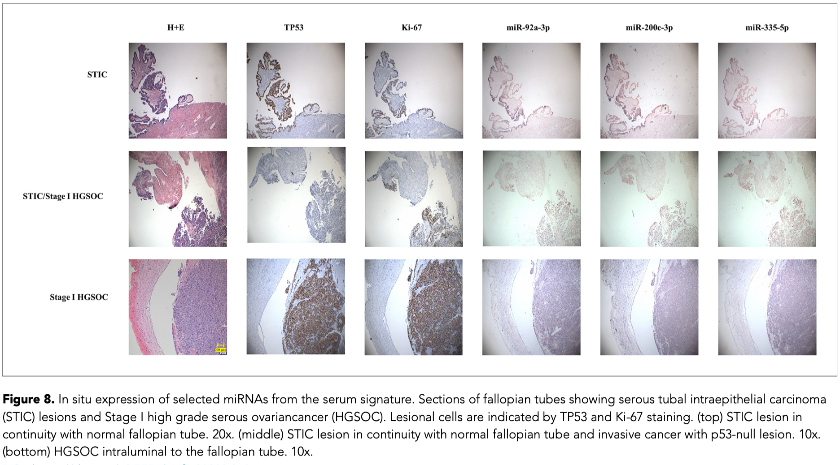
15/18

Slide 17
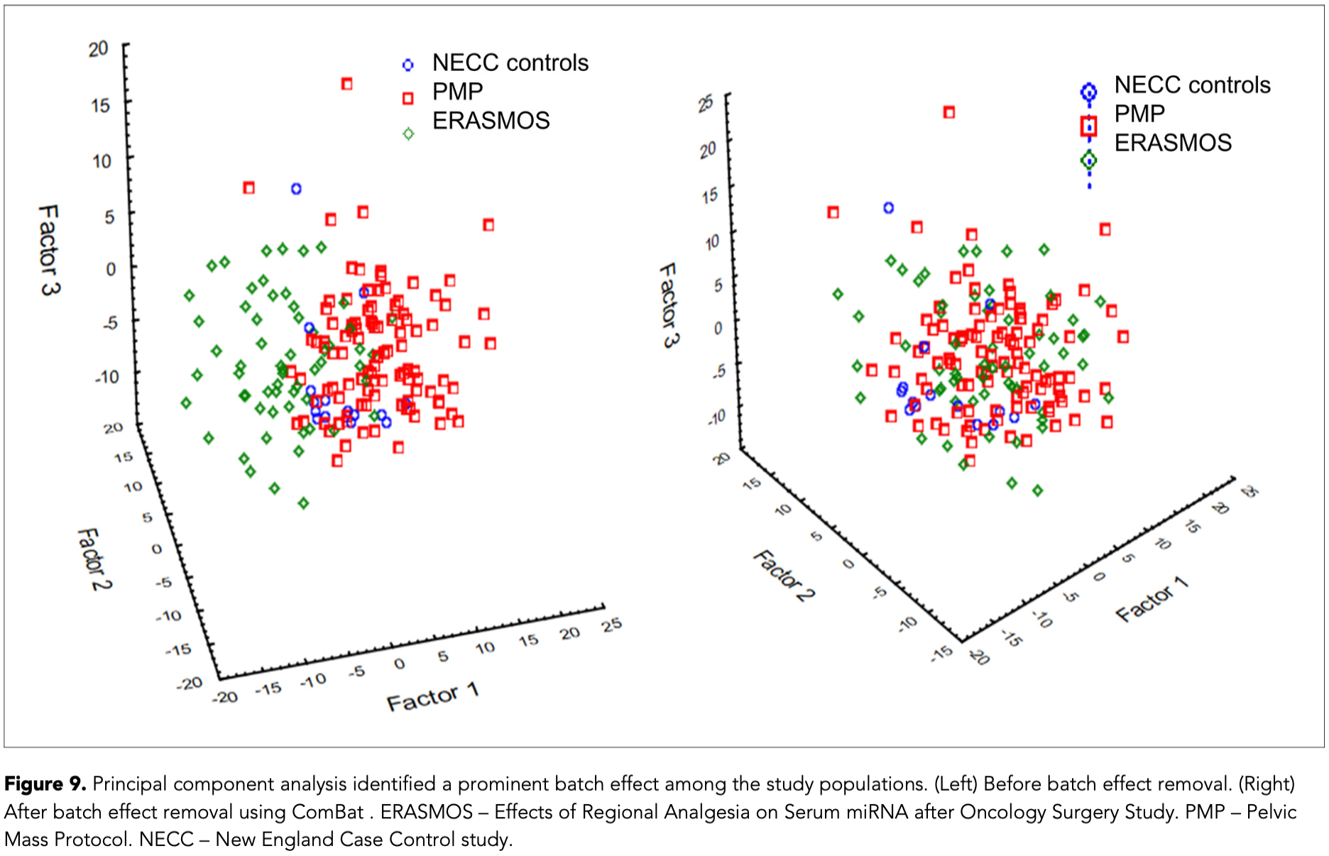
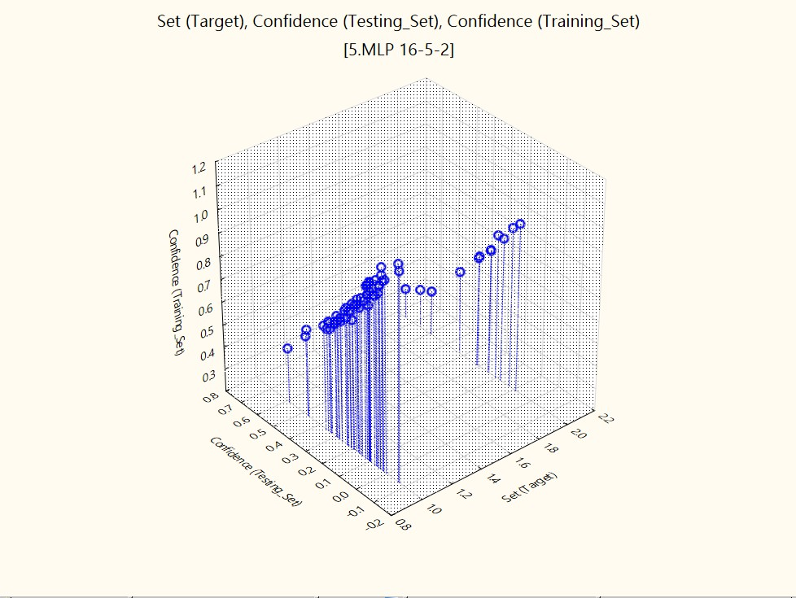
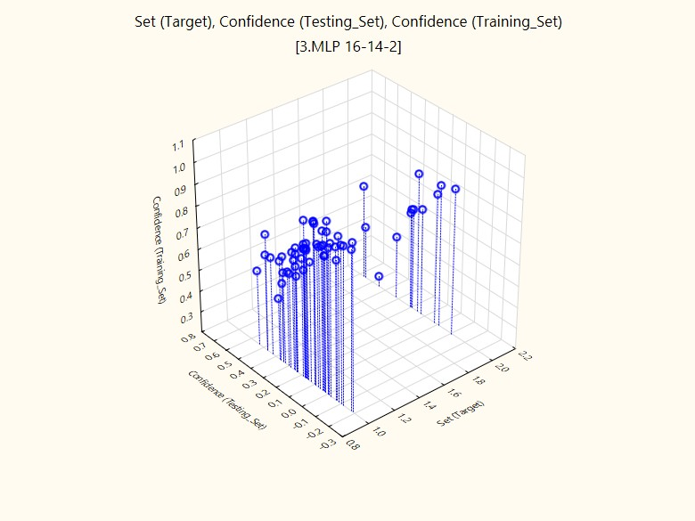
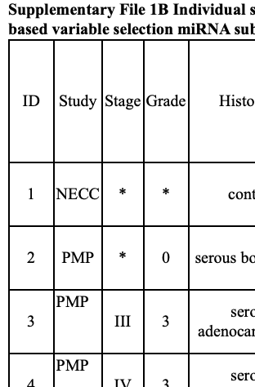
Figure 9
Data from Supplemental Datasets 1 and 2 (File 6)
Used STATISTICA Data Miner (PCA function)
We didn’t find a way to make the dots different representations, but the label can be found in Supplemental File 1B
16/18

Slide 18
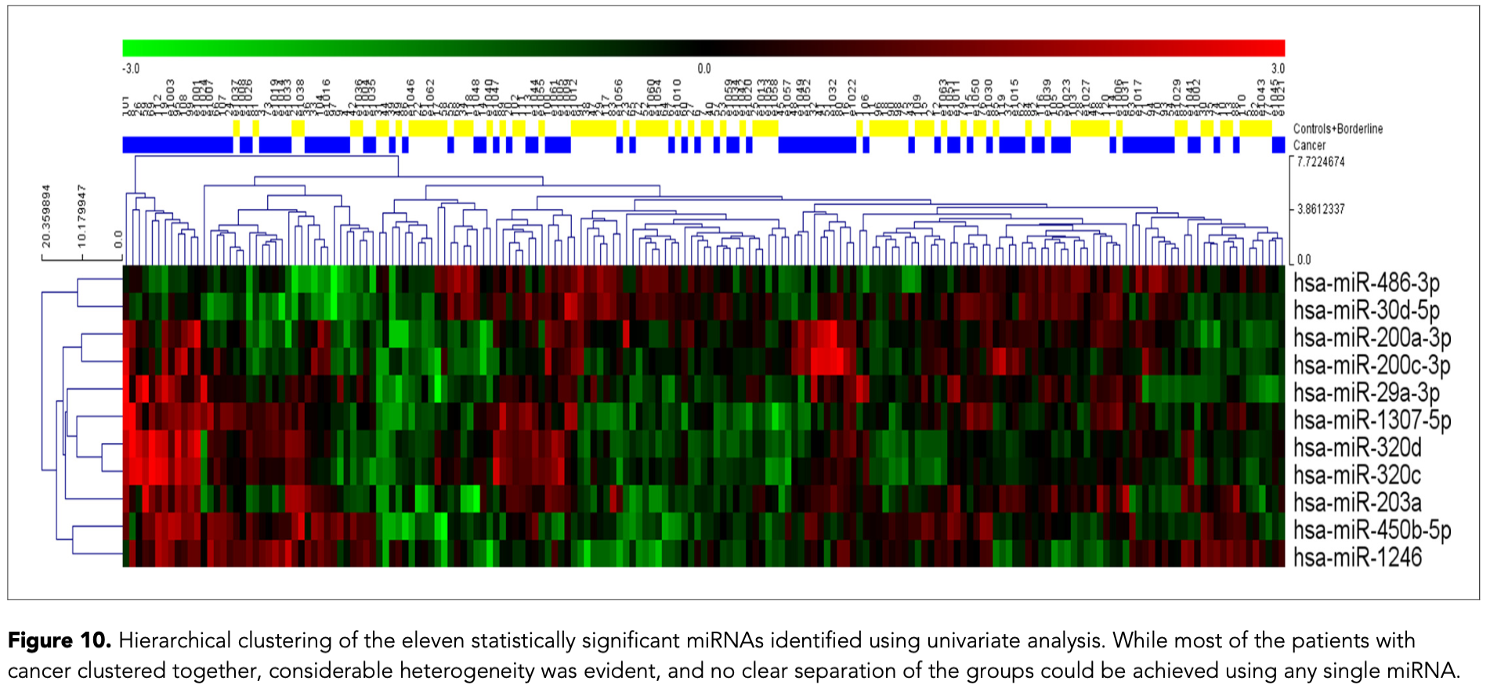
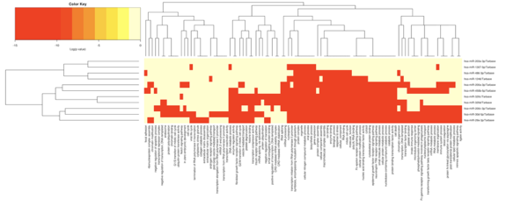
hsa-miR-203a
Now with -3p or -5p
Figure 10
We don’t know what tool is used…
We used mirPath v.3 web tool https://dianalab.e-ce.uth.gr/html/mirpathv3/index.php?r=mirpath
Input miRNAs (data from miRNA database) and show heatmap
17/18

Slide 19
Quick Review
Achieve | Figure | Reason/Resource
- | 1 | Flow chart, no code involved
- | 2 | Values given, no code involved
F | 3 | Model not built – connection too slow
F | 4
T | 5 | Used Supplemental Dataset 7 (File 6)
- | 6 | No external test set information
? | 7 | Sup. DS 8 w/ pairwise Wilcoxon test R code
- | 8 | Photos… no code involved
T | 9 | Sup. DS 1&2 (1 with post processing)
T | 10 | mirPath v3 web toole with online database
18/18

Slide 20

Q&A

